Slide 1
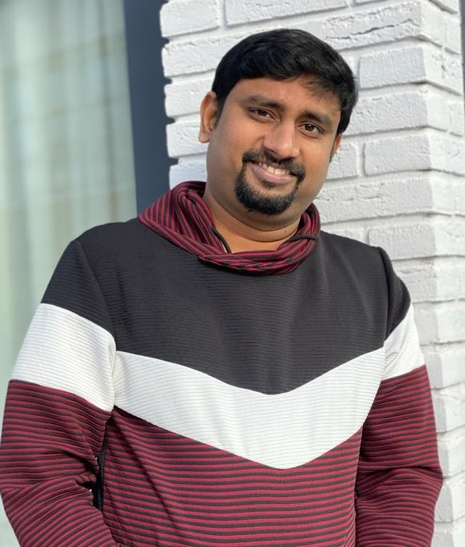
Senior DevOps Lead – Onshore
Background
Motivation/Goals
Experienced in all phases of the software development life cycle (SDLC) with specific focus on the build and release of quality software and as an efficient and organized Software professional in DevOps Engineering - Build, Configuration and Release management domain and its tools. Experienced in Waterfall, Agile/Scrum, and Continuous Integration (CI) and Continuous Deployment (CD) practices.
Proactively communicate with various business areas/leaders to understand short and long term plans ensuring that applications meet the requirements for the end-users and the business
Expert in enabling collaboration for global teams by effective leadership and management skills with a proven ability to implement and manage DevOps programs including support.
Focus on Devops Enablement with various tools and technologies
Refining co-ordination between different teams
Focus on Automation and Innovation
Standardization on Devops processes, frameworks, etc.
Mentoring fellow team members and train them in taking up added responsibilities at ease
Adhering to Industry Standards and improvising on the same
Narrative
Daniel holds 14+ years of IT industry experience in Software Configuration Management, Build and Deployment management, Release and Change Management with a strong focus on enabling Devops with various clients of Healthcare, Life Science, Retail and BFS.
Patented Cognizant Product Inventor - https://priorart.ip.com/IPCOM/000245438
Roles and Experience
Skills
Behaviors
Competent Technical Devops Engineer with handson experience in Cloud, Source Code Migration from on-prem to cloud, Devops enablement by setting up End to End automated CI CD setup including Continuous testing until production.
Development/Improvisation of Automation on various activities with build / deployments across multiple environments
Version Control tools: Rational Clearcase, GIT, Atlassian Bitbucket, Subversion, Azure DevOps, POWER
Build tools: Ant, Maven
Continuous Integration tools: Jenkins, Bamboo, AnthillPro,
Code coverage & Quality: Sonarqube, JUnit
Infra Configuration, Deployment Management: Chef, Ansible, XL Deploy, Terraform
Containerization tools: Docker, Kubernetes
Operating Systems: UNIX, Solaris, Windows.
Cloud Services: AWS & Azure
Orchestration Tools: XL Release
Supporting tools: Stash, Jira, Perl, Shell, Batch, Confluence, Artifactory, Nexus, Remedy 7, Snow, Groovy pipeline
Empathetic
Passion towards work
Leadership qualities
Self-motivated
Innovative
Quest for Learning
Flexible
Team player
Focused
Result oriented
Adaptive
Trouble Shooter

Slide 2

Senior DevOps Lead - Onshore
Background
Motivation/Goals
Conduct System Design, feasibility, Cost studies and recommend cost-effective Cloud and DevOps Solutions.
Advise software development teams on architecting, designing Interfaces and infrastructures that safely and efficiently power the cloud environment
Designed, configured and deployed Microsoft Azure for a multitude of applications utilizing the Azure stack as part of POC
Development of Automation through terraform, ansible, groovy, python and chef and Enablement of DevSecOps Programs within Multiple Agile teams
Adhering to Industry Standards and improvising on the same
Refining co-ordination between different teams
Automation
Narrative
Shashikant Bangera 19 Years of IT experience and around 10 years of experience in DevOps and Cloud, Excellent communication, interpersonal, analytical and presentation skills. Author of book DevOps for Serverless Application with Packt Publication, Reviewer of 4 Docker books published by Packt Publication Successfully designed and delivered secure Cloud and DevOps solutions for major organisations with various different domain, Earned a reputation for designing cloud deployment strategies that mitigate risk while meeting infrastructure, employee, customer and budgetary needs.
Roles and Experience
Skills
Behaviors
Managed Docker orchestration and Docker containerisation using Kubernetes
Designed a DevOps maturity model and highlighted Key areas of improvement
Manage the DevOps Centre of Excellence and the related Developers
Languages Terraform, Python and Ansible, Gradle, Chef, Shell and Groovy Cloud Plaforms AWS,AZURE and Google Concepts Safe Agile, Scrum and Kanban Tools Gitlab CI/CD,, New Relic, Jmeter, Graylog, ElasticSearch, Nagios, Munin, App-dynamics, New-Relic, Jenkins, Kubernetes, Terraform, ELK, Docker, JIRA, Rally, Confluence, GIT, BITBUCKET and Vagrant
Empathetic
Trouble shooter
Consulting
Leadership
Dependable team player
Credible
Creative
Flexible / Adaptable
Quest for learning

